Slide 1
Optimize Supply Chain Cost under Trade-war
Objective: Minimize cost by shifting products between existing factories due to tariffs impact.
Assumptions:
Focus 1 product only (iPhone XS max)
Customer only consider US market
Factory Locations (India, China, Brazil – could have to add more)
Components list and their landed cost to supply factories
Tariffs tax % for Raw Material and Finished Goods
Logistics cost from factory to US market
Factory capacity
Each factory has same production cost (?)
No difference between Foxconn or Wistron producing iPhone (or should we focus only on Apple – Foxconn supply-chain partnership?)
We are ignoring the technological constraints of quality of phones produced i.e. Not all plants of Foxconn/Wistron can produce the latest iPhones

Slide 2
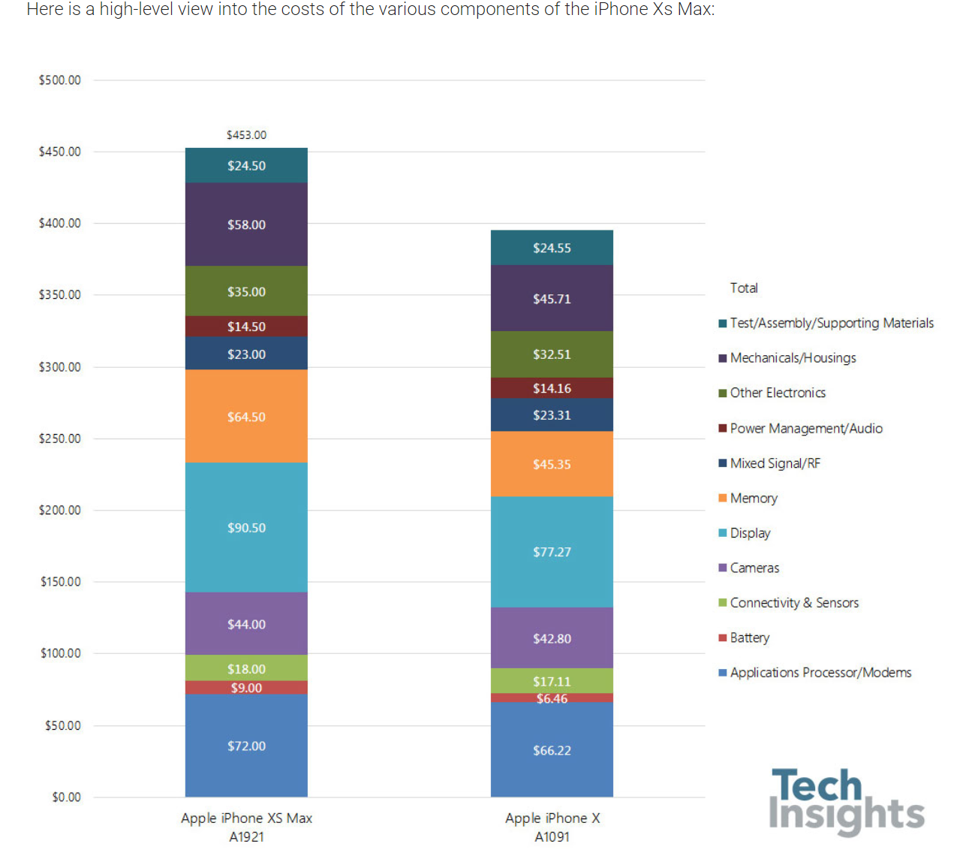

Slide 3

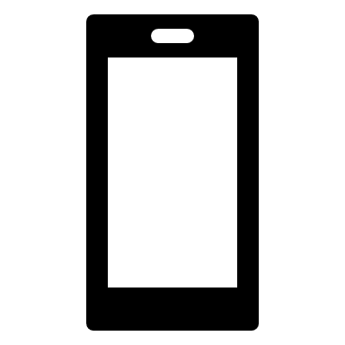




Apple’s Supply Chain Network
Raw Material Suppliers
Assembly Factories
US DC and Customers
Japan:
Display, Camera
China
Taiwan:
Memory
India
Korea:
Battery, Processors
Mexico
US:
Processors and Chips
Notes:
https://www.macworld.co.uk/feature/apple/where-are-apple-products-made-3633832/
Accelerometer: Bosch in Germany. Invensense in the United States.
Audio Chipsets and Codec: Cirrus Logic in the United States (outsourced for manufacturing).
Baseband processor: Qualcomm in the United States (outsourced for manufacturing).
Batteries: Samsung in South Korea. Huizhou Desay Battery in China.
Cameras: Sony in Japan. OmniVision in the United States produces the front-facing FaceTime camera chip but subcontracts TMSC (in Taiwan) for manufacturing.
Chipsets and Processors: Samsung in South Korea and TSMC in Taiwan. Alongside their partner GlobalFoundries in the United States.
Controller Chips: PMC Sierra and Broadcom Corp in the United States (outsourced for manufacturing).
Display: Japan Display and Sharp in Japan. LG Display in South Korea.
DRAM: TSMC in Taiwan. SK Hynix in South Korea.
eCompass: Alps Electric in Japan.
Fingerprint sensor authentication: Authentec makes it in China but outsources it to Taiwan for manufacturing.
Flash memory: Toshiba in Japan and Samsung in South Korea.
Gyroscope: STMicroelectronics in France and Italy.
Inductor coils (audio): TDK in Japan.
Main Chassis Assembly: Foxconn and Pegatron in China.
Mixed-signal chips (such as NFC): NXP in Netherlands.
Plastic Constructions (for the iPhone 5c): Hi-P and Green Point in Singapore.
Radio Frequency Modules: Win Semiconductors (module manufacturers Avago and RF Micro Devices) in Taiwan. Avago technologies and TriQuint Semiconductor in the United States. Qualcomm in the United States for LTE connectivity.
Screen and Glass (for the display): Corning (Gorilla Glass) in the United States. GT Advanced Technologies produces the sapphire crystals in the screens.
Semiconductors: Texas Instruments, Fairchild and Maxim Integrated in the United States.
Touch ID sensor: TSMC and Xintec in Taiwan.
Touchscreen Controller: Broadcom in the United States (outsourced for manufacturing).
Transmitter and Amplification Modules: Skyworks and Qorvo in the United States (outsourced for manufacturing).

